Slide 1
Employee Data Analysis using Excel
STUDENT NAME: Poorva.R.C
REGISTER NO: 312215853
DEPARTMENT: B.com Accounting and Finance
COLLEGE: Shri Shankarlal Sundarbai Shasun Jain College for Women

Slide 2
PROJECT TITLE
Employee Performance Analysis using Excel

Slide 3


AGENDA
Problem Statement
Project Overview
End Users
Our Solution and Proposition
Dataset Description
Modelling Approach
Results and Discussion
Conclusion
3/21/2024 Annual Review

Slide 4

PROBLEM STATEMENT
In the fast-paced corporate environment, maintaining high employee performance is crucial. However, organizations often struggle to identify the key factors influencing employee productivity. This project aims to analyze employee performance data to pinpoint these factors and suggest actionable improvements.”

Slide 5

PROJECT OVERVIEW
The project focuses on analyzing a dataset containing various employee metrics like attendance, project involvement, and performance scores. The goal is to use Excel-based analysis to identify patterns and correlations that can guide management in enhancing employee productivity.”
.

Slide 6

WHO ARE THE END USERS?
The primary end users are HR Managers, Team Leaders, and Senior Management. This analysis will help them make informed decisions regarding employee development and performance improvement strategies."

Slide 7

OUR SOLUTION AND ITS VALUE PROPOSITION
Our Solution:"We utilized Excel to perform data cleaning, correlation analysis, and visualization to uncover hidden patterns in the employee data. The analysis reveals critical factors such as the impact of consistent attendance and skill development on performance
Value Proposition:"By identifying these key factors, our solution enables organizations to implement targeted strategies, such as personalized training programs and attendance incentives, leading to a more engaged and productive workforce."

Slide 8
Dataset Description
• Employee data set taken fromthe KAGGLE.
• In dataset , out of 26 data I took only 9 features out of it.
• The selected 10 features are listed below:
1. Employee ID
2. First name
3. Last name
4. Business unit
5. Employee type
6. Employee status
7. Employee classification type
8. Gender code
9. Performance score
10. Current employee rating

Slide 9

THE "WOW" IN OUR SOLUTION
"Our solution stands out by leveraging advanced Excel functions like pivot tables and conditional formatting to create dynamic, interactive dashboards. These tools allow management to quickly visualize and drill down into the data, making the insights both accessible and actionable."
3/21/2024 Annual Review
9

Slide 10
MODELLING
1. DATA COLLECTION
• The data has been collected through edunet dash board.
2.FEATURE COLLECTION
• The listed 10 features were taken for the analysis of data.
3. DATA CLEANING
• Identifying the missing values.
• Filtering of those missing values.
4. CALCULATION OF PERFORMANCE LEVEL
• By considering the current employee rating, i found the performance level using the formula.
5. SUMMARY OF PIVOT LEVEL
• Segregating of certain features to rows, columns, heading and so on.
6. VISUALIZATION
• Once completed with pivot table, created the graph for precise visualisation.
10

Slide 11
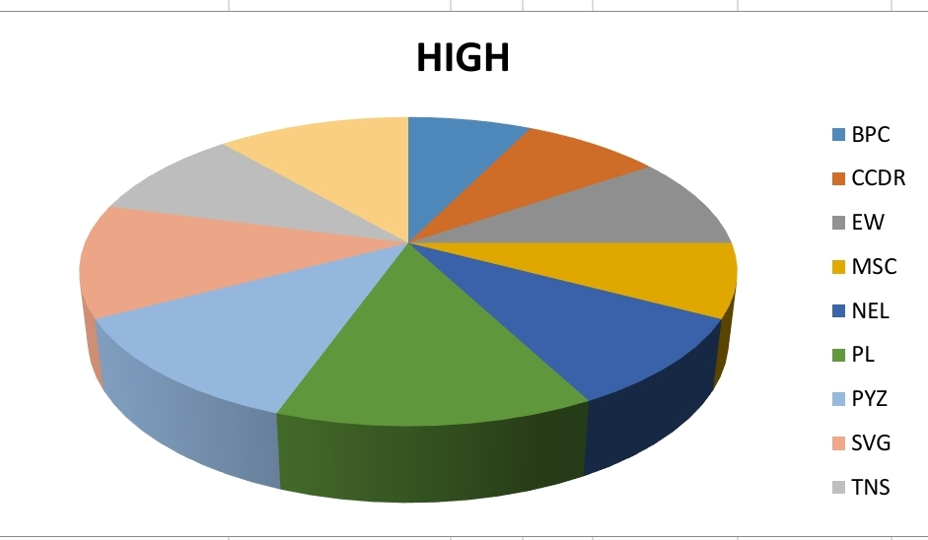
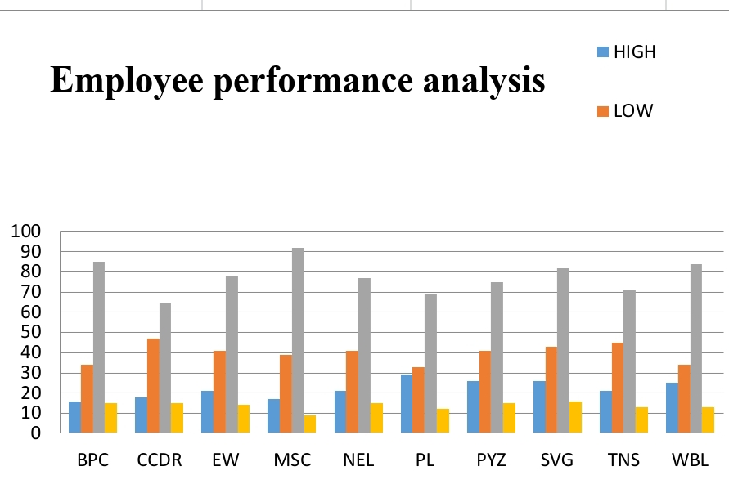
RESULTS
=IF(AND(Z8>=5),"VERY HIGH",IF(AND(Z8>=4),"HIGH",IF(AND(Z8>=3),"MED","LOW")))
11

Slide 12
conclusion
The analysis provides clear evidence that regular attendance and active project participation are critical to high employee performance. We recommend implementing a rewards system for attendance and creating more opportunities for employees to engage in key projects. These steps are likely to result in a more motivated and high-performing workforce.

